Slide 1
Fundamentals of Machine Learning and Neural Networks
Leonardo Bocchi and Jacqueline Bumler

Slide 2
SUMMARY
Main principles & concepts of ML
When is machine learning used
Not an exact approach
Feasibility of the ML problem
The Machine Learning pipeline
Handling the data
The importance of data
Data manipulation
Main principles & concepts of DL & ANNs
Can computers think?
Types of ML models and ML problems
Supervised learning
Unsupervised learning
Quick Neuroscience concepts
Artificial Neural Networks (ANNs)
Activation functions
Some applications of ML and DL
The Machine Learning environment
Some practical examples

Slide 3
MAIN PRINCIPLES & CONCEPTS OF ML
When is machine learning used
Not an exact approach
The Machine Learning pipeline
Handling the data
The importance of data
Data manipulation

Slide 4
WHEN IS MACHINE LEARNING USED
THERE IS A PATTERN
WE CANNOT PIN IT DOWN MATHEMATICALLY
WE HAVE DATA ON IT

Slide 5
NOT AN EXACT APPROACH
IS MACHINE LEARNING A MATHEMATICALLY EXACT APPROACH?
NO
It’s more similar to an engineering approach; it is needed where exact methods cannot be applied
DOES MACHINE LEARNING PROVIDE AN EXACT SOLUTION TO A PROBLEM?
NO
Machine Learning is a method to infer an implicit function as the solution to our problem

Slide 6
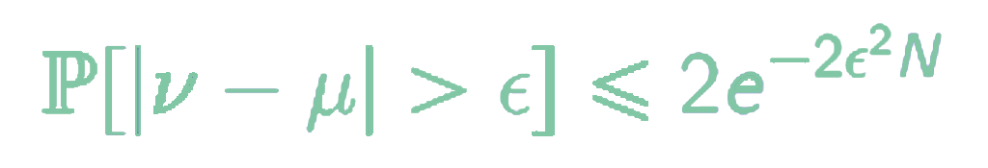
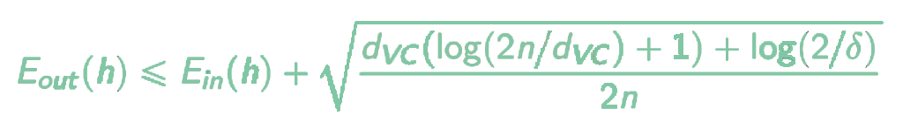
FEASIBILITY OF THE ML PROBLEM
What mathematical certainty do we have that this approach to the problem works?
Hoeffding’s Inequality

Slide 7
THE MACHINE LEARNING PIPELINE
DATA
TRAIN A CLASSIFIER
MODEL

Slide 8
THE MACHINE LEARNING PIPELINE
TRAINING DATA
FIT/TRAIN A CLASSIFIER
MODEL
DATA
TEST
DATA
TEST / PREDICT
PREDICTIONS

Slide 9
THE MACHINE LEARNING PIPELINE
TRAINING DATA
FIT/TRAIN A CLASSIFIER
DATA
MODEL
TEST
DATA
TEST / PREDICT
PREDICTIONS
EVALUATE

Slide 10
THE MACHINE LEARNING PIPELINE
FEATURE EXTRACTION
+
PREPROC.
TRAINING DATA
FIT/TRAIN A CLASSIFIER
DATA
MODEL
FEATURE EXTRACTION
+
PREPROC.
TEST
DATA
TEST / PREDICT
PREDICTIONS
EVALUATE

Slide 11
HANDLING THE DATA
How can we assess the performance of our model?
DATA
Available data
TRAINING SET
Train/fit the model
VALIDATION SET
Compare the performance of different models
TEST SET
Assess the performance of the model

Slide 12
THE IMPORTANCE OF DATA
The effectiveness of a machine learning model relies heavily on the quality of data
MACHINE LEARNING PROBLEM
DATA
MODEL
DATA MANIPULATION
IMPROVE THE MODEL

Slide 13
DATA MANIPULATION
Feature extraction
Normalization & Scaling
Handling the outliers
Handling missing values & Inputting
One-hot encoding
Feature Hashing

Slide 14
MAIN PRINCIPLES & CONCEPTS OF DL & ANNs
Can computers think?
Types of ML models and ML problems
Supervised learning
Unsupervised learning
Quick Neuroscience concepts
Artificial Neural Networks (ANNs)
Activation functions

Slide 15

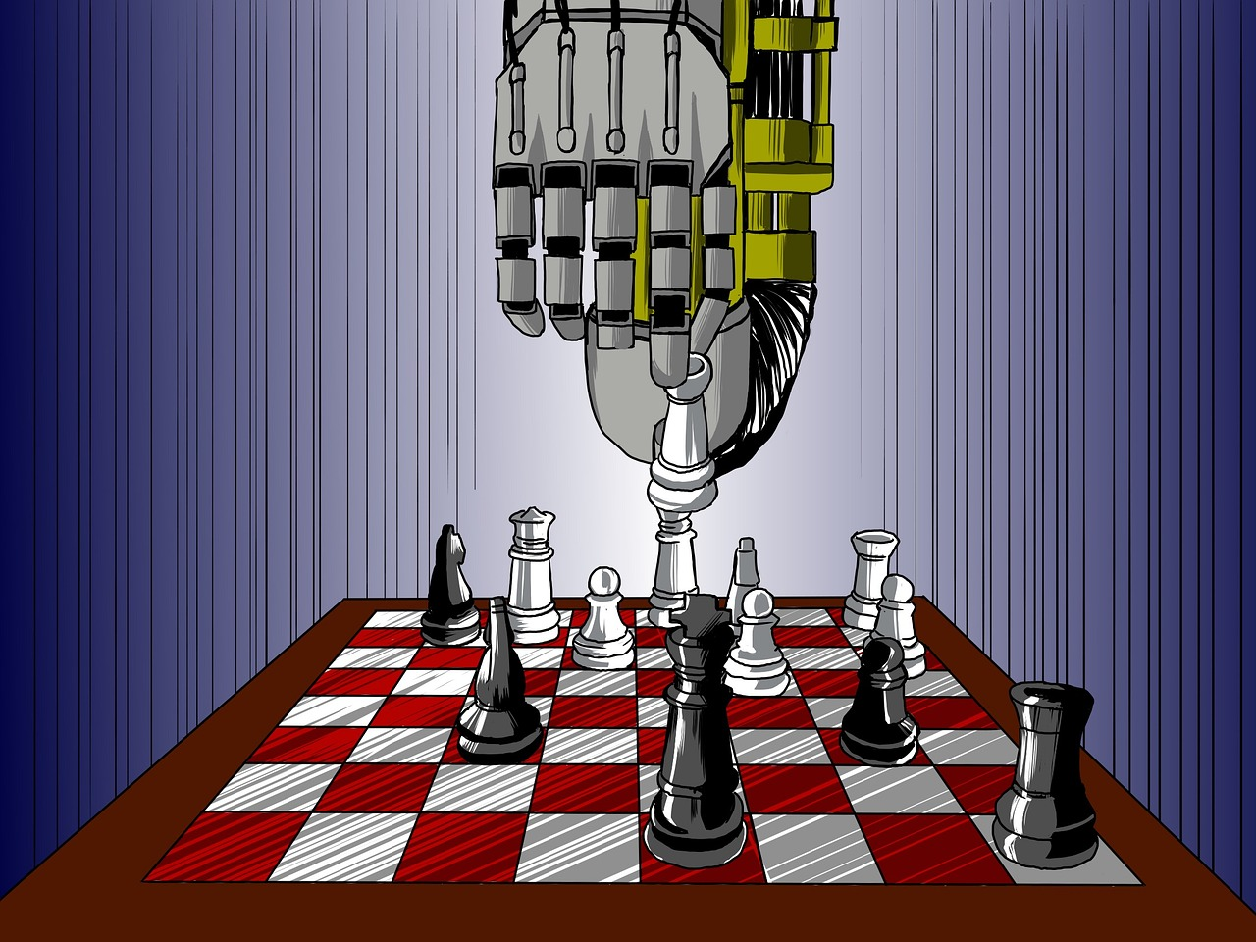
CAN COMPUTERS THINK?

Slide 16
TYPES OF MACHINE LEARNING MODELS
Predictive or supervised learning: (AKA pattern recognition) given a labelled data set called training set, find a mapping from x to y (e.g. regression, classification)
Descriptive or unsupervised learning: (AKA knowledge discovery) given a data set find something interesting or useful about their structure (e.g. density estimation, clustering, dimensionality reduction)
Reinforcement learning: given an external system upon which you can exert control action a and receive percepts p, a reward signal r indicating good performance, find a mapping from P → A that maximizes some long-term measure of r

Slide 17
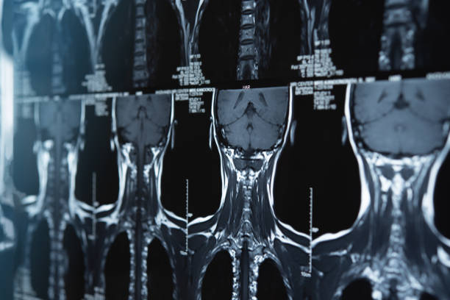

SUPERVISED LEARNING
Supervised learning:
Models a function to relate inputs and outputs
Uses known examples to learn
Example: is cancer present in a given x-ray?
Inputs: numerical data representing images of cancerous and non cancerous x-rays
The goal of supervised learning is generalization
Successfully predict an output given new inputs
Uses previously observed data

Slide 18
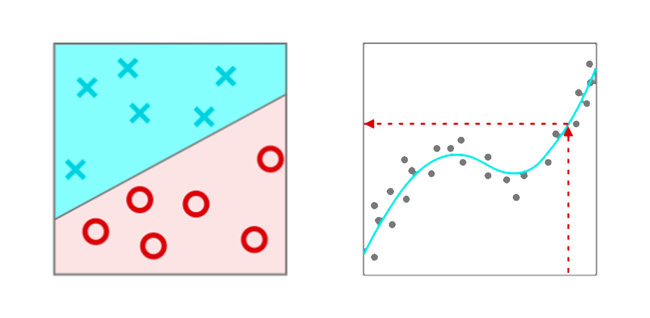
SUPERVISED LEARNING: CLASSIFICATION VS REGRESSION
Classification
Classifying data into distinct categories through a decision boundary
Ex: cancer present or no
Regression
Uses a function to relate inputs to numerical outputs
Ex: predicting how many cancerous cells after given number of days
Classification
Regression

Slide 19
UNSUPERVISED LEARNING
Finds patterns among inputs and groups the data according to similarities in structure
Supervised vs Unsupervised
Supervised algorithms:
trained with example outputs
Ex: one x-ray shows cancer, another does not
Unsupervised algorithms
no example outputs; untrained
Ex: discovers similarities in all x-rays that have cancer present and groups them together

Slide 20
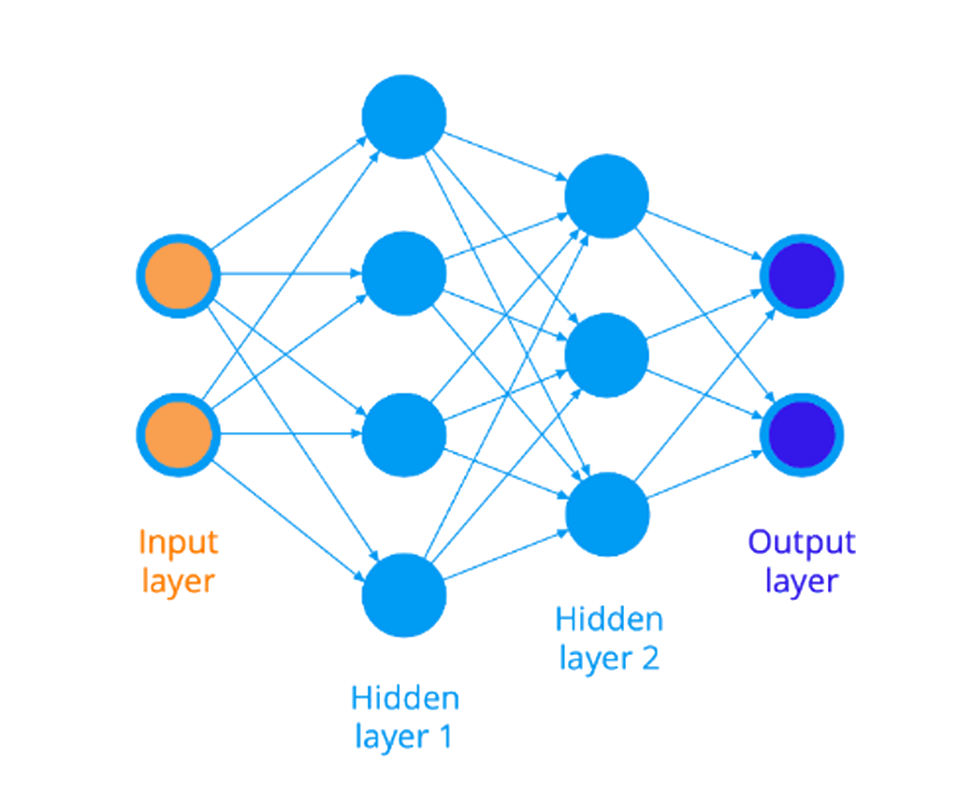
ARTIFICIAL NEURAL NETWORKS (ANNs)
ANNs use both supervised and unsupervised learning
Originally invented to understand functions of the human brain
Ex: facial recognition
Eyes are brown or blue?
Skin is dark or light?
Freckles or no?

Slide 21
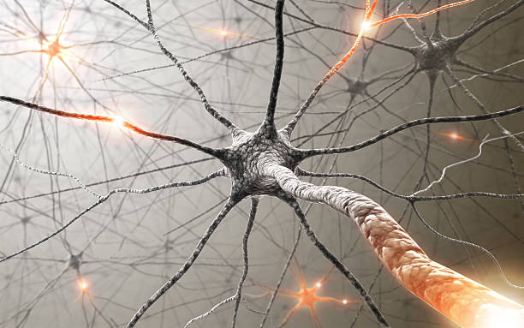
QUICK NEUROSCIENCE CONCEPTS
Neurons are brain cells
Send and receive information
Synapses are connections
Strengthening and weakening of connections between neurons → network evolves → brain “learns”
Neurons integrate and fire impulses
performs computations with inputs → fires if passes threshold

Slide 22
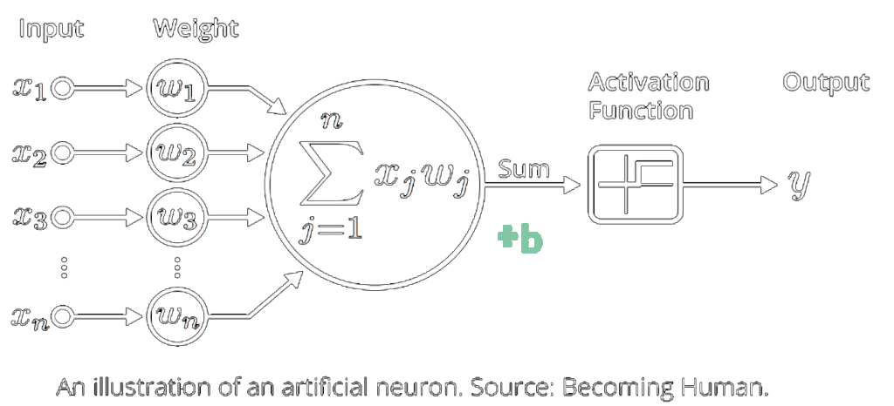
Artificial Neural Networks (ANNs)
Inputs combined into a weighted sum
Weights represent strength of connection
Pass weighted sum + bias through an activation function
Bias used to control threshold
Neuron example: If surpasses threshold, fires
Activation function is a step function in this case

Slide 23
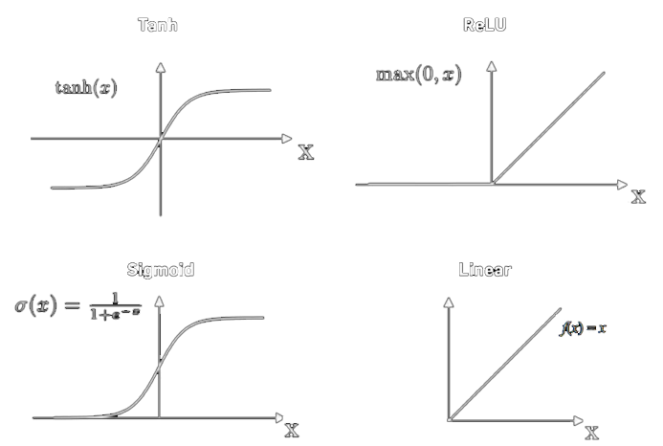
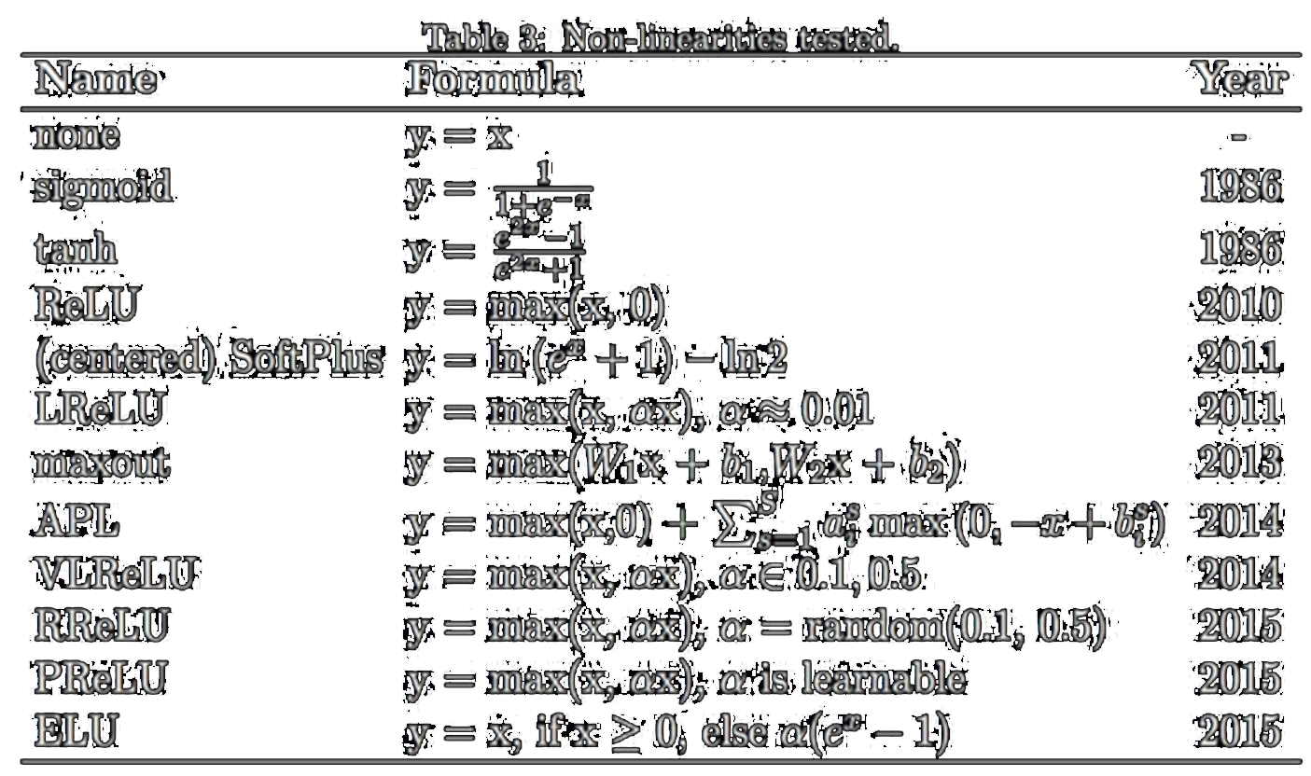
ACTIVATION FUNCTIONS

Slide 24
SOME APPLICATIONS OF ML AND DL
The Machine Learning environment
Some practical examples

Slide 25






THE MACHINE LEARNING ENVIRONMENT

Slide 26
SOME PRACTICAL EXAMPLES
Neural Networks: an easy problem
Neural Networks: the network’s architecture
Neural Networks: increasing the network’s dimension
Neural Networks: increasing the problem’s complexity
Our implementation of a solution to the spiral problem

